Slide 1

DEPARTMENTAL LIBRARY MANAGEMENT SYSTEM
Group No: 01

Slide 2
Presented by :-
Miss. Niharika Viraj Achrekar (02)
Mr. Dhiraj Rakesh Sahani (32)
Mr. Alvin (35)
Mr. Shubham Anil Shinde (52)
Mr. Sanmesh Sanjay Sawant (57)
Project Guide :-
Prof .Miss.P.P.Farakte

Slide 3

Outline :-
Introduction
Literature Review
Proposed Work
Block Diagram
Components
Objective
Flowchart
Expected Outcome

Slide 4
Introduction
The Departmental Library Management System. In an era driven by information and technology, managing resources and facilitating easy access to knowledge is paramount. Our project aims to revolutionize the way academic institutions handle their libraries, offering a comprehensive solution that empowers both students and staff.
The Departmental Library Management System is designed to streamline and enhance the traditional library experience. This digital platform not only manages the physical collection of books but also integrates seamlessly with the digital resources available today. It embodies the fusion of technology and education, enabling users to explore, learn, and grow in an environment tailored for efficiency and convenience.
With this system, library administrators can efficiently catalog, organize, and track books, journals, and other learning materials.

Slide 5
Literature Review :-
[1].Morium Morshe “Open-Source Library Management System”, Brac University Department of Computer Science and Engineering in September 2008.
[2].Adebesin Tobi Tosin “Library Management System” The Department of Computer Science, Faculty of Science, Federal University Ekiti, State, Nigeria in October, 2015.
[3].Prabhakar Kumar, Rahul Kumar, Rajat Singh, Vikram Pratap Singh “Library Management System” By Cochin University of Science & Technology Kochi 2014.
[4].Shanmugam, Ramalakshmi, Sasthri, Baalachandran, “Library Management System” Article in Journal of Xi An University Of Architecture & Technology Coimbatore In December 2020

Slide 6
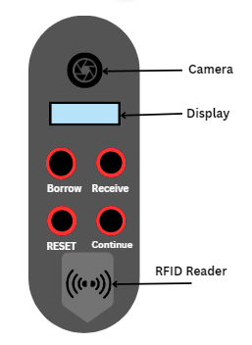
PROPOSED WORK :-
The proposed work for the Departmental Library Management System (DLMS) project encompasses a series of systematic steps and activities aimed at designing, developing, and implementing an efficient and user-friendly library management solution tailored specifically for departmental libraries within educational institutions. The project's scope and objectives are outlined below:
1. System Design
2. Database Development
3. User Interface Development
4. Resource Cataloguing and Integration
5. Analytics and Reporting
6. User Training and Documentation

Slide 7
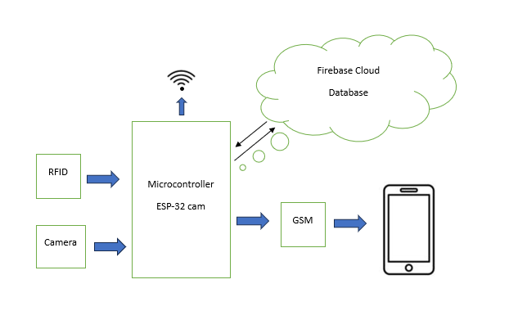
Block Diagram

Slide 8
Objective :-
Automate tasks related to resource circulation, reporting, and inventory.
Implement security measures to protect user data and privacy.
Collect and analyze data to inform resource acquisition and library policy decisions.
Efficiently manage and allocate resources within departmental libraries.

Slide 9
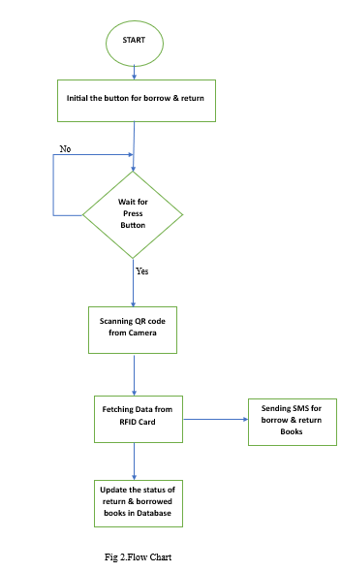
FLOW CHART:-

Slide 10
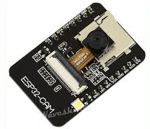
Component List:-
Sr No Item
1 ARDUINO UNO
2 ESP32-CAM
3 ESP8266
4 SIM 800L GSM MODULE
5 FIREBASE SCBSCRIPTION
6 SIM CARD RECHARGE
7 RFID CARD
8 16X2 LCD DISPLAY
9 EM-18 RFID READER
10 METAL BODY

Slide 11
Expected Outcome :
Improved Resource Accessibility.
Efficient Resource Utilization.
Real-time Availability Updates Reduced Risk of Loss or Misplacement.
Enhanced Project TimeLine.
Data-driven Decision-making.
Streamlined Record-keeping and Documentation.
Improved Student and Faculty Satisfaction.
Optimized Return on Investment, Scalability and Adaptability.

